Slide 1
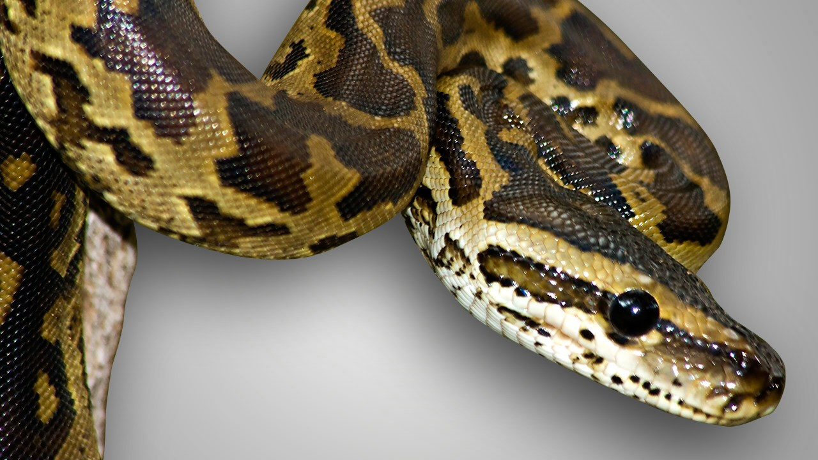
WELCOME

Slide 2
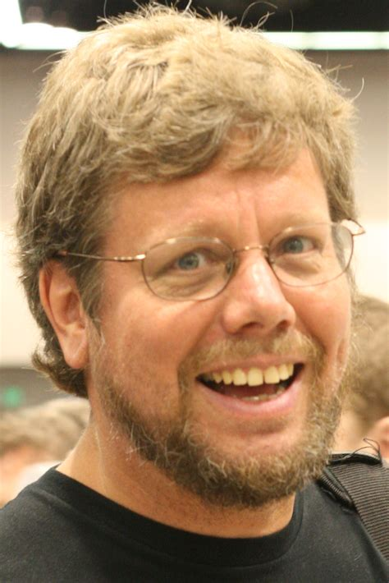
CREATOR
Guido van Rossum.
Dutch programmer.

Slide 3
Monty Python
British comedy group.
Python is derived from this.
spam and eggs.

Slide 4
Python versions
Python 1.0 →1994
Python 2.0 → 2000
Python 3.0 → 2008

Slide 5
WHAT IS PYTHON?

Slide 6
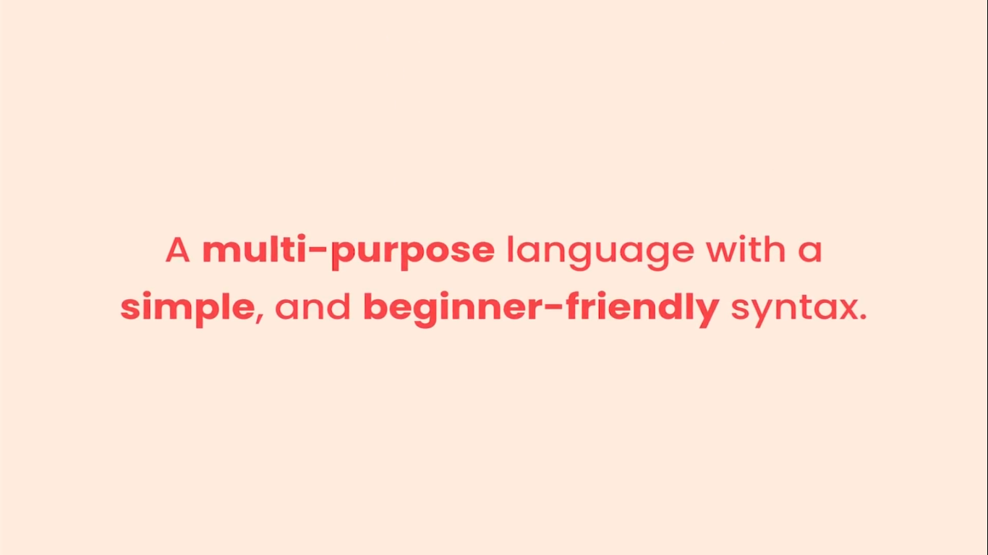
SIMPLE

Slide 7
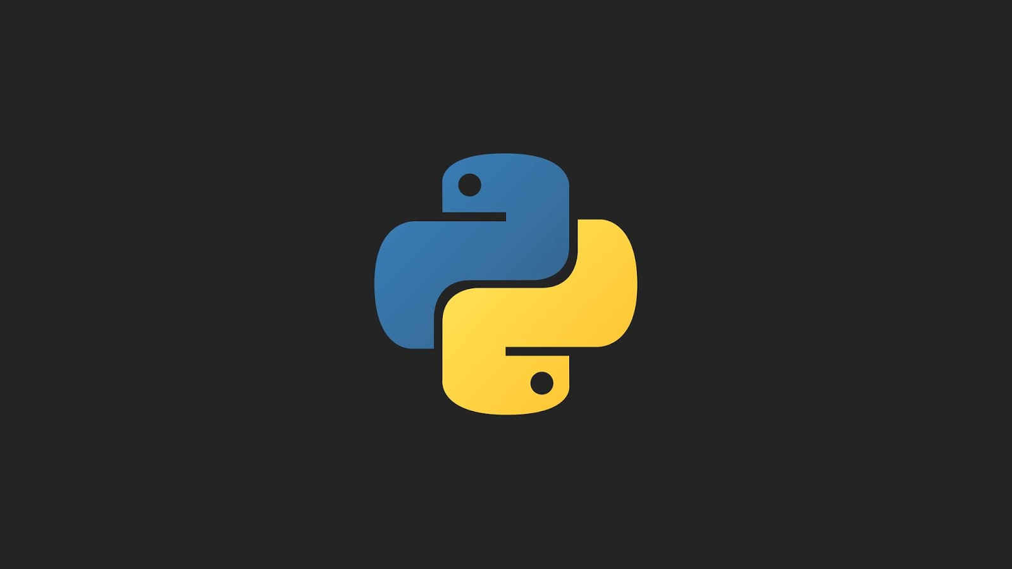
PYTHON LOGO

Slide 8
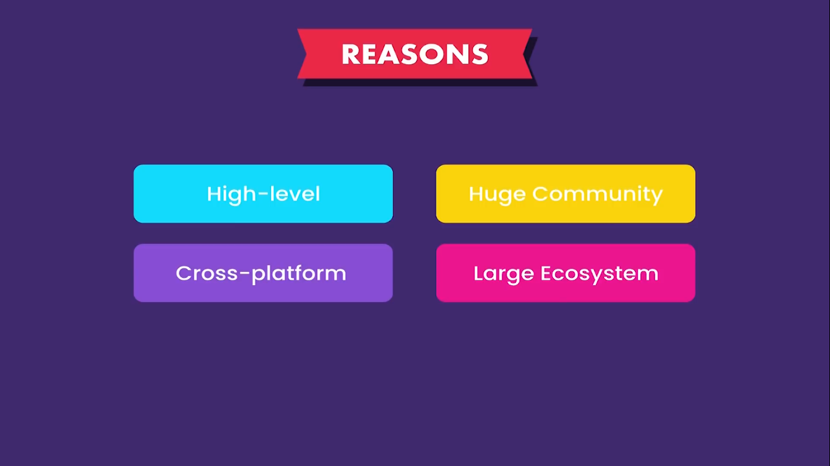
WHY PYTHON POPULAR?

Slide 9
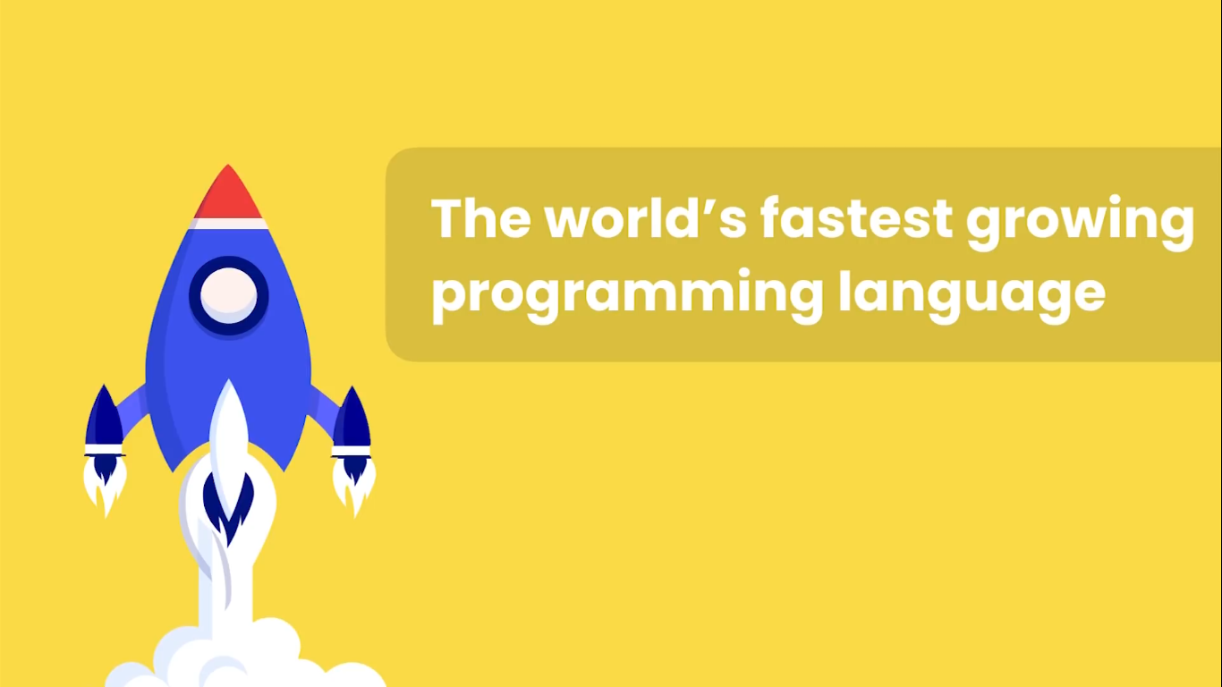

Slide 10
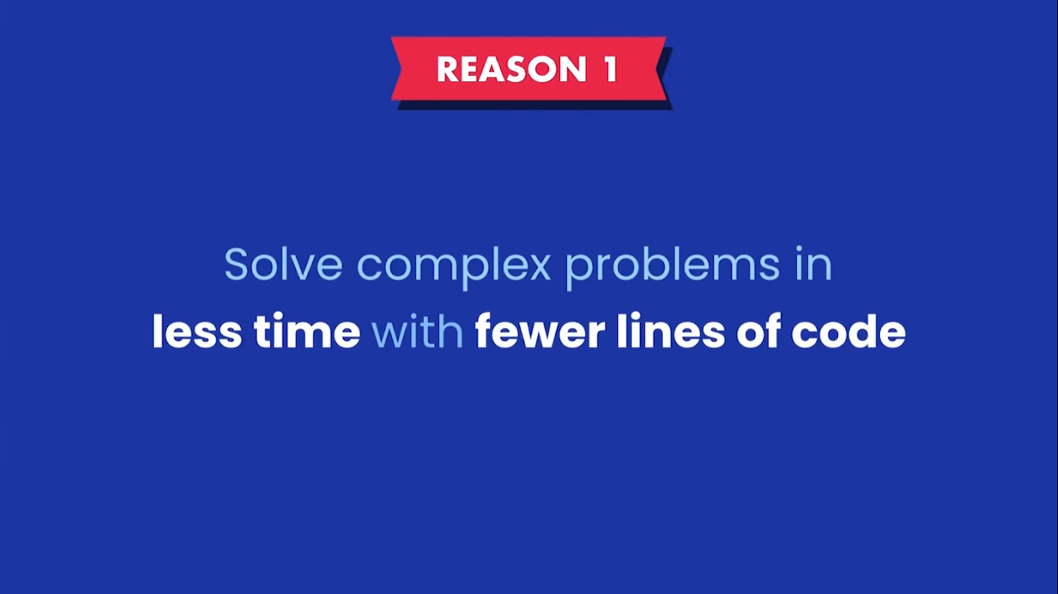

Slide 11
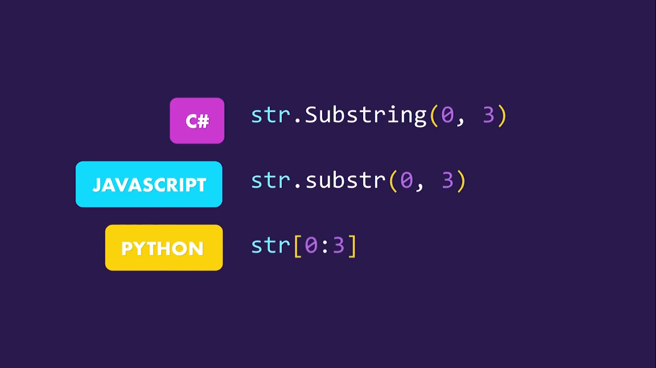

Slide 12
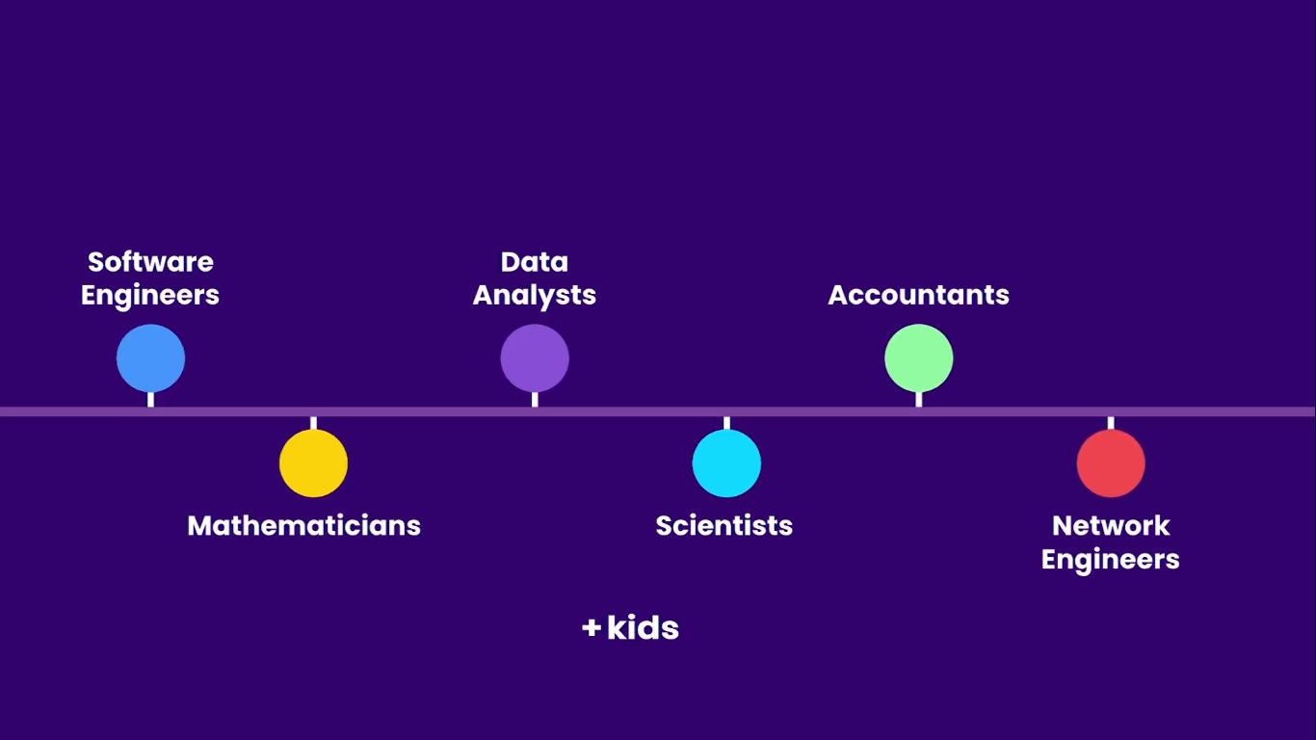
WHO USES PYTHON?

Slide 13
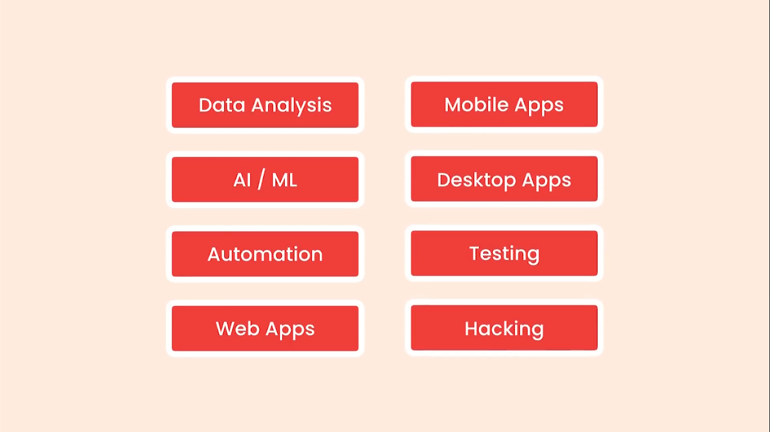
APPLICATIONS

Slide 14
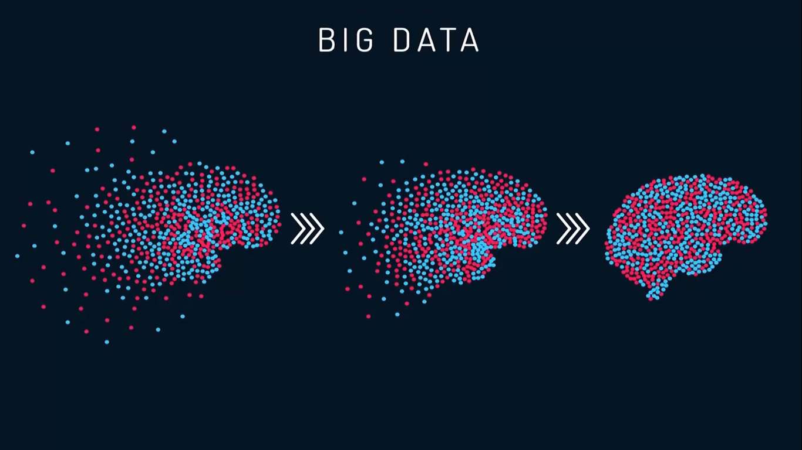

Slide 15
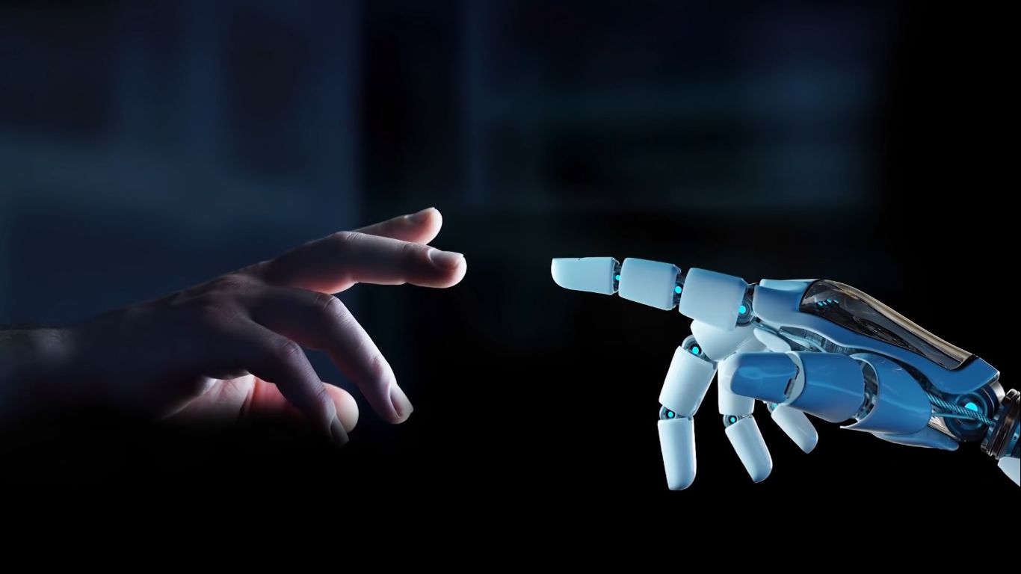
ARTIFICIAL INTELLIGENCE AND MACHINE LEARNING

Slide 16
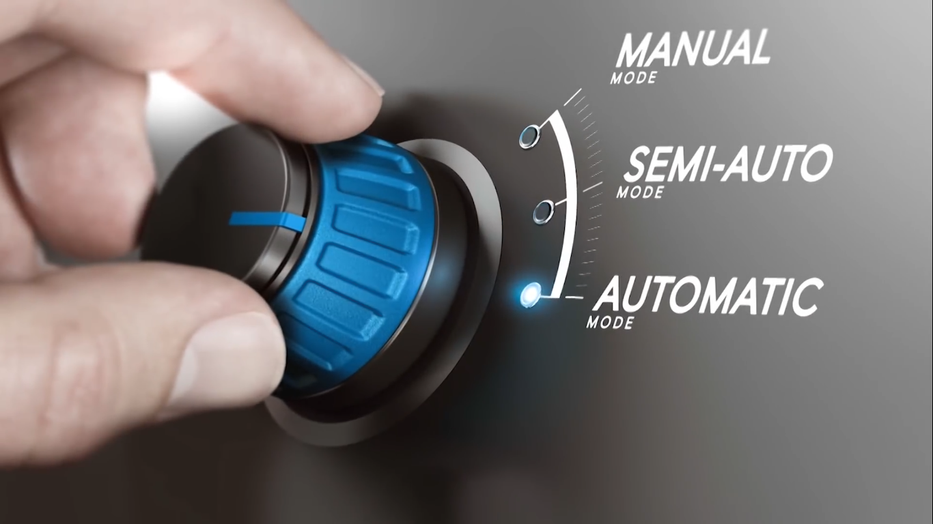
AUTOMATION

Slide 17
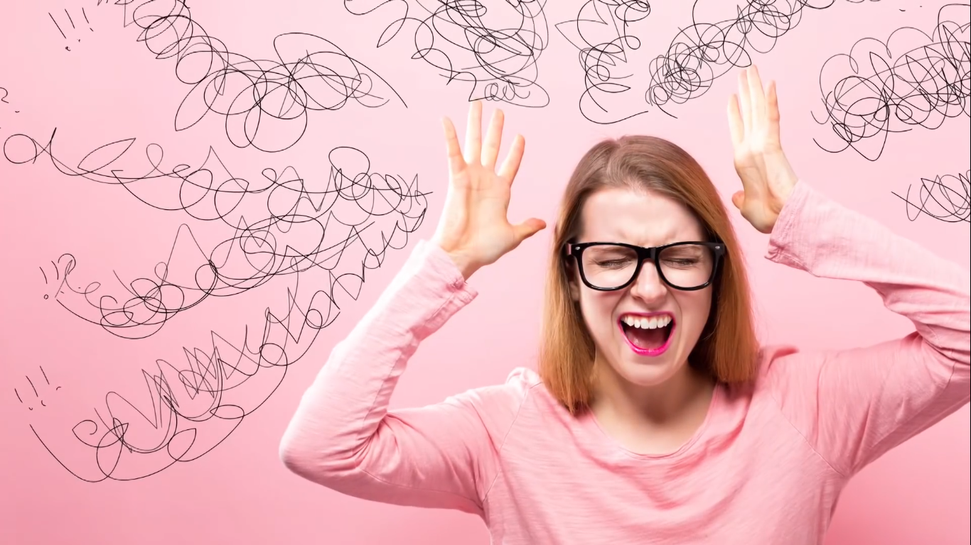
REPETITIVE TASKS

Slide 18
